Slide 1
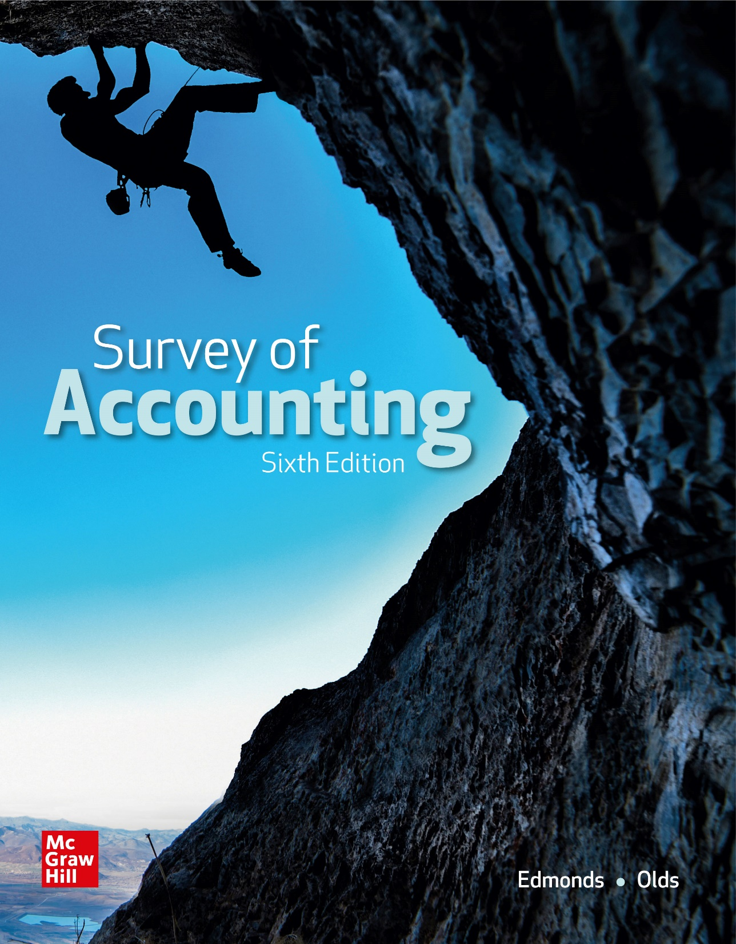
Chapter 1
An Introduction to
Accounting

Slide 2
Collecting and Organizing Information
Accounting is an information system that reports on the economic activities and financial condition of a business or other organization.

Slide 3
LO 1-1:
Identify the ways accounting benefits society.

Slide 4
Role of Accounting in Society
How should society allocate its resources? Should we spend more money to harvest food or cure disease?

Slide 5
Role of Accounting in Society Continued
Should we build computers or cars? Should we invest money in IBM or General Motors?
Accounting provides information that helps answer such questions.

Slide 6
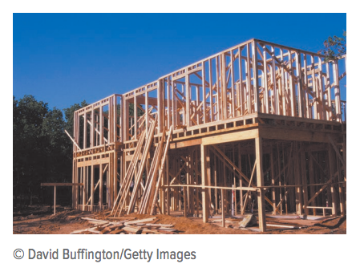
Market-Based Allocations
A market is a group of people or entities organized to exchange items of value.

Slide 7
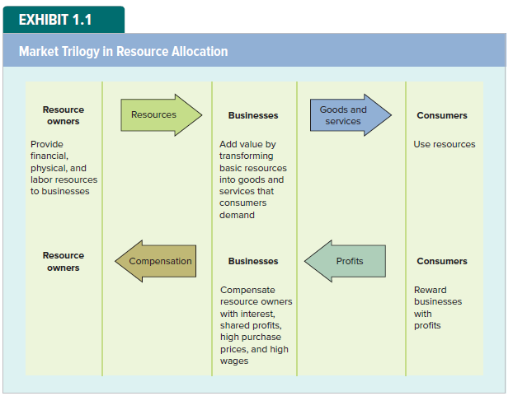
Market Trilogy in Resource Allocation

Slide 8
Market-Based Allocations Continued
Common terms for the added value created in the transformation process:
Profit
Income
Earnings

Slide 9
Financial Resources
Businesses need financial resources (money) to establish and operate their businesses.
Investors
Creditors

Slide 10
Physical Resources
In their most primitive form, physical resources are natural resources.
Owners of physical resources seek to sell those resources to profitable businesses which are able to pay higher prices and make repeat purchases.

Slide 11
Labor Resources
Labor resources include both intellectual and physical labor. Workers seek relationships with businesses that have high earnings potential because these businesses are better able to pay high wages.

Slide 12
Types of Accounting Information
Financial Accounting
Focused on the needs of external users
Managerial Accounting
Focused on the needs of internal users
Notes:
4 financial statements

Slide 13
Nonbusiness Resource Usage
Not all entities allocate resources based on profitability. Organizations that are not motivated by profit are called not-for-profit entities.
Governments allocate resources for national defense, to reallocate wealth, or to protect the environment.
Foundations, religious groups, and various benevolent organizations allocate resources based on humanitarian concerns.

Slide 14
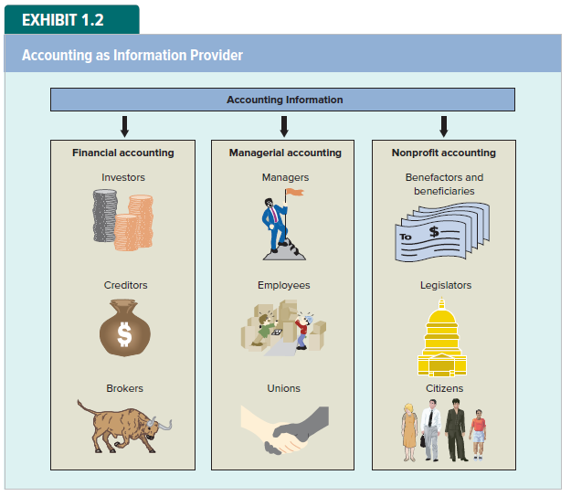
Accounting as Resource Provider

Slide 15
Accounting Improves Communication
Accountants establish measurement and reporting rules that businesses use to facilitate communication.
FASB
Generally Accepted Accounting Principles

Slide 16
Focus on International Issues
Until recently, each country developed its own unique GAAP. Global companies were required to prepare multiple sets of financial statements.
To address the need for a common set of financial standards, the International Accounting Standards Committee was formed in 1973.
The committee was reorganized as the International Accounting Standards Board (IASB) in 2001.

Slide 17
Careers in Accounting
Public Accounting
Private Accounting
Certified Public Accountant
Audit services
Tax services
Consulting services
Certified Management Accountant
Certified Internal Auditor

Slide 18
LO 1-2:
Identify reporting entities.

Slide 19
Reporting Entities
Financial accounting reports disclose the financial activities of particular individuals or organizations described as reporting entities. Each entity is treated as a separate reporting unit.
Businesses
Individuals
Organizations

Slide 20
LO 1-3:
Identify the components of the accounting equation.

Slide 21
The Accounting Equation
The Accounting Equation is composed of three elements: assets, liabilities and stockholders’ equity. Stockholders’ equity is subdivided into two additional elements called common stock and retained earnings.
Businesses use resources to conduct their operations. The resources a business uses to earn money are called assets.

Slide 22
Creating an Accounting Equation
Assets = Claims
Claims on the assets are from three sources:
Creditors (liabilities)
Investors (stockholders’ equity)
Operations (profits increase assets)
Assets = Liabilities + Stockholders’ equity

Slide 23
Creating an Accounting Equation Continued
Commitments made to investors are described in certificates called common stock.
Assets = Liabilities + Stockholders’ equity
Common Stock
Retained Earnings
Increases to stockholders’ equity from earnings are called retained earnings.
Notes:
Important equation
Liabilities: balance sheet: as od Dec 31st… Note payable/Loan payable
Income statement: for the year earned Dec 31st…

Slide 24
Elements of Financial Statements
The elements represent broad categories.
Assets
Liabilities
Stockholders’ Equity

Slide 25
Using Accounts to Gather Information
Assets – Cash, Equipment, Buildings, Land
Liabilities
Stockholders’ Equity
Detailed information about elements is maintained in accounts.
Not all business entities use the same accounts or account names.

Slide 26
LO 4:
Show how business events affect the accounting equation.

Slide 27
Recording Business Events Under an Accounting Equation
An accounting event is an economic occurrence that changes an entity’s assets, liabilities, or stockholders’ equity. A transaction is a particular kind of event that involves transferring something of value between two entities.

Slide 28
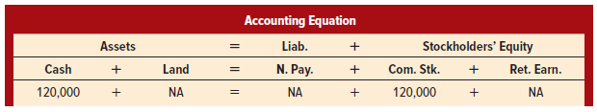
Asset Source Transactions
Event 1: Rustic Camp Sites (RCS) was formed on January 1, Year 1, when it acquired $120,000 cash from issuing common stock.
RCS increases assets (cash).
RCS increases stockholders’ equity (common stock).
Double-Entry Bookkeeping
Recorded Twice

Slide 29
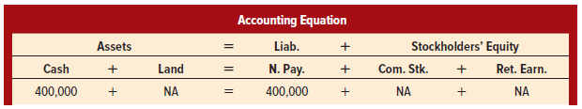
An Asset Source Transaction
Event 2: RCS acquired an additional $400,000 of cash by borrowing from a creditor.
RCS increases assets (cash).
RCS increases liabilities (notes payable).

Slide 30
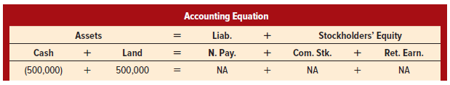
Asset Exchange Transaction
Event 3: RCS paid $500,000 cash to purchase land.
RCS decreases assets (cash).
RCS increases assets (land).
Asset exchange

Slide 31
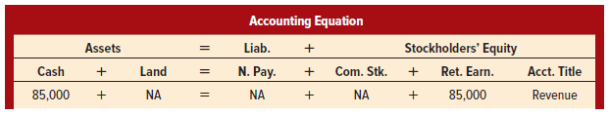
Another Asset Source Transaction
Event 4: RCS obtained $85,000 cash by leasing campsites to customers.
RCS increases assets (cash).
RCS increases stockholders’ equity (retained earnings).
revenues

Slide 32
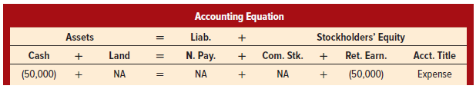
Asset Use Transaction
Event 5: RCS paid $50,000 cash for operating expenses such as salaries, rent, and interest.
RCS decreases assets (cash).
RCS decreases stockholders’ equity (retained earnings).
expenses

Slide 33
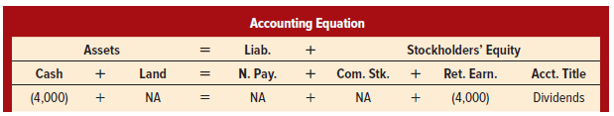
Another Asset Use Transaction
Event 6: RCS paid $4,000 in cash dividends to its owners.
RCS decreases assets (cash).
RCS decreases stockholders’ equity (retained earnings).
dividends

Slide 34
Changes in Market Value
Event 7: The land that RCS paid $500,000 to purchase had an appraised market value of $525,000 on December 31, Year 1.
Historical Cost Concept
Requires that most assets be reported at the amount paid for them (their historical cost) regardless of increases in market value.

Slide 35
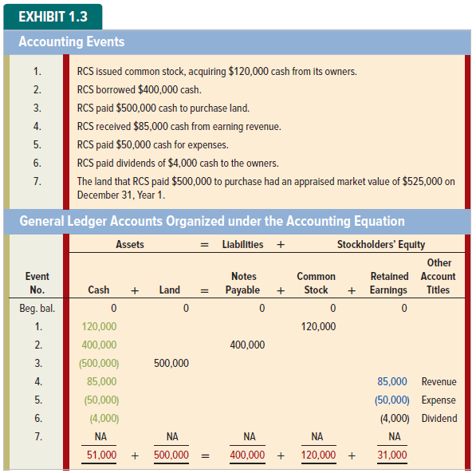
Summary of Accounting Events

Slide 36
Summary of Accounting Events

Slide 37
LO 5:
Interpret information shown in an accounting equation.

Slide 38
The Left versus the Right Side of the Accounting Equation
Assets are displayed on the left side of the accounting equation. Assets include cash, but are not always cash.
The right side of the equation
is NOT related to the amount of actual cash a company has on hand.
The right side of the accounting equation identifies the sources of the company’s assets, NOT their composition.

Slide 39
Cash and Retained Earnings
While Retained Earnings does not represent the amount of cash on hand, it does limit the amount of cash that can be used to pay dividends.
So, both Cash and Retained Earnings are needed to pay cash dividends.
Dividends are distributions of assets generated through earnings

Slide 40
Business Liquidations
Liquidations can result from net losses or mismanagement of assets.
Creditors have priority, and investors receive any residual.
Going Concern
Assumes that a business is able to continue operations into the foreseeable future.

Slide 41
Two Views of the Right Side of the Accounting Equation
Sources of the company’s assets.
View One
Obligations of the company to return creditor assets.
View Two
Stewardship
Is the duty to
protect and
use assets for the benefit of the owners.
Commitments of the company to investor-provided assets.

Slide 42
LO 6:
Classify business events as asset source, use, or exchange transactions.

Slide 43
Recap: Types of Transactions
The described transactions have been classified into one of three categories:
Asset Source
Asset Exchange
Asset Use
Increase one asset, decrease another asset
Increase total assets, increase total claims
Decrease total assets, decrease total claims

Slide 44
LO 7:
Prepare an income statement, a statement of changes in stockholders’ equity, and a balance sheet.

Slide 45
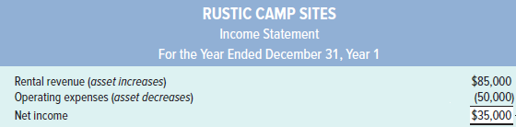
Income Statement and the Matching Concept
{
Matching Concept
Revenues exceeded expenses. If expenses exceed revenues, the entity will report a net loss.
Revenues (benefits) are matched to expenses (sacrifices).
Income is measured for a span of time called the accounting period.

Slide 46
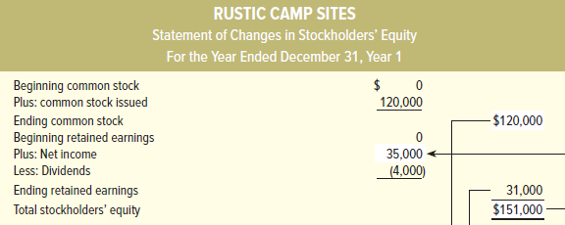


Statement of Changes in Stockholders’ Equity

Slide 47
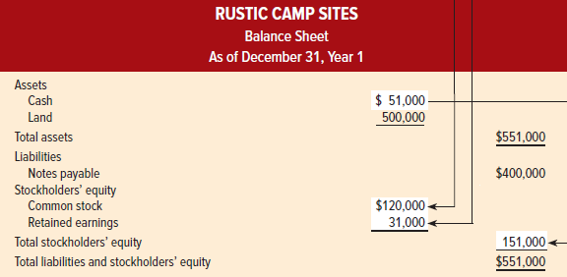



Balance Sheet

Slide 48
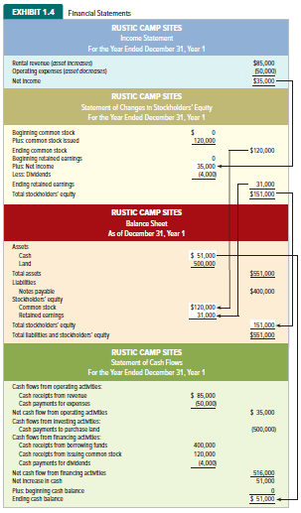
Financial Statements

Slide 49
LO 8:
Prepare a statement of cash flows.

Slide 50
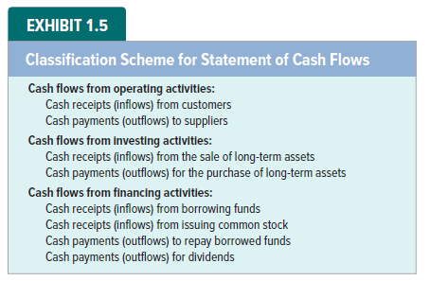
Statement of Cash Flows

Slide 51
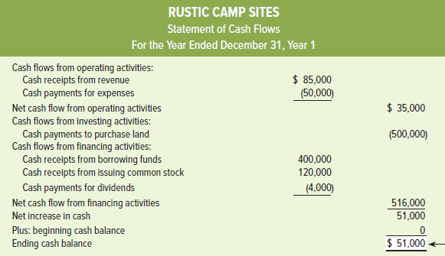

Statement of Cash Flows for Rustic Camp Sites

Slide 52
LO 9:
Distinguish between permanent and temporary accounts.

Slide 53
Closing Temporary Accounts to Retained Earnings
The process of transferring information from the revenue, expense, and dividend (temporary) accounts to the Retained Earnings account is called closing.
Since the Retained Earnings carries forward from one accounting period to the next, it is considered a permanent account.

Slide 54
LO 10:
Record business events using a horizontal financial statements model.

Slide 55
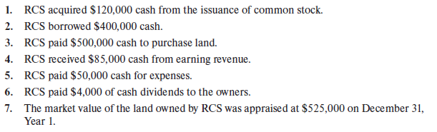
Accounting Events for RCS During Year 1

Slide 56
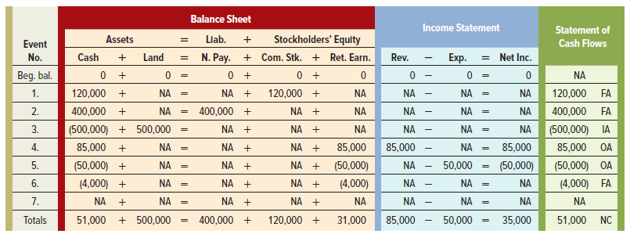
Horizontal Financial Statements Model

Slide 57
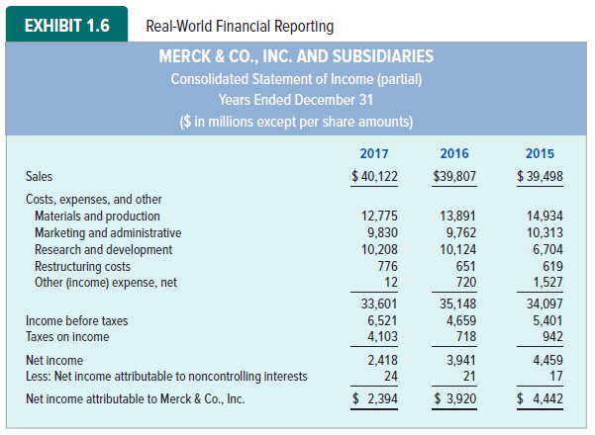
Real-World Financial Reports

Slide 58
Annual Report
Consists of:
Financial Statements
Notes
Auditors’ Report –Chapter 4
Management’s Discussion and Analysis (MD&A)
The U.S. Securities and Exchange Commission (SEC) requires publicly traded corporations to file a 10-K report, which contains more detailed financial information, and frequently substitutes for the annual report.

Slide 59
Special Terms in Real-World Reports
The financial statements of real-world companies include numerous items relating to advanced topics that are not covered in introductory accounting textbooks.
However, we encourage you to look for annual reports in the library, from your employer, or on the Internet. Look for links labeled “about the company” or “investor relations.”

Slide 60
End of Chapter 1

